Slide 1
Unsupervised Learning
Agricultural Data Analysis
- Abhishek Mukherjee

Slide 2
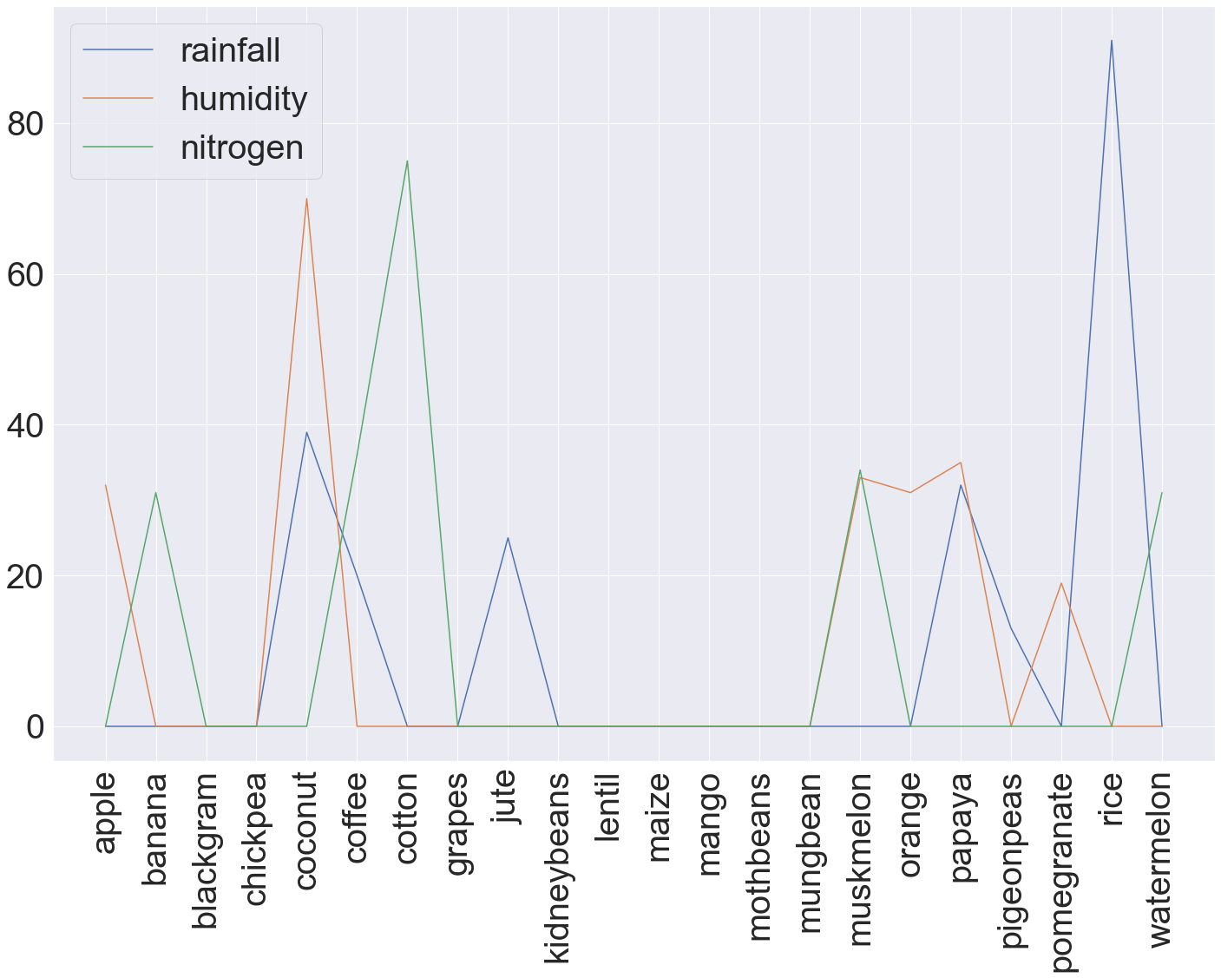
Crops which need extreme weather conditions: Rice, Papaya, Muskmelon, Jute , Coconut, Apple Crops which need extreme Nitrogen conditions. The yield of these crops would be improved with availability of pesticides: Watermelon, Muskmelon, Cotton, Banana
Instances of crops requiring extreme weather or nitrogen conditions

Slide 3
We end up with soft clusters here as same crops as mapped to multiple sets which is acceptable to business would prioritize sets based on various parameters and come up with a final set cultivation per agricultural cycle
Crops which can be grown together
Set 1 – maize, chickpea , kidneybeans , pigeonpeas, mothbeans, mungbean, blackgram, lentil, pomegranate, mango, orange, papaya, coconut
Set 2 - maize, banana, watermelon, muskmelon, papaya, cotton, coffee
Set 3 - grapes, apple
Set 4 - rice, pigeonpeas, papaya, coconut, jute, coffee

Slide 4
Best fit crop as per given data
For the following combination:
Ratio of Nitrogen content in soil – 20
Ratio of Phosphorus content in soil – 30
Ratio of Potassium content in soil – 10
Temperature in degree Celsius – 15
Relative Humidity % - 90
pH value of soil – 7.5
Rainfall in mm – 100
Orange is the best suited crop

